Slide 1

6th Grade Math
Unit 8, Lesson 11 Surface Area of a Rectangular Pyramid Volume 2, pg. 130

Slide 2


Benchmark
MA.6.GR.2.4
Given a mathematical or real-world context, find the surface area of right rectangular prisms and right rectangular pyramids using the figure’s net.
volume 2, pg. 130

Slide 3
Integrated Mathematical Thinking and Reasoning Standards
MA.K12.MTR.1.1 Actively participate in effortful learning both individually and collectively.
MA.K12.MTR.2.1 Demonstrate understanding by representing problems in multiple ways.
MA.K12.MTR.4.1 Engage in discussions that reflect on the mathematical thinking of self and others.
MA.K12.MTR.5.1 Use patterns and structure to help understand and connect mathematical concepts.
MA.K12.MTR.7.1 Apply mathematics to real-world contexts.
volume 2, pg. 130

Slide 4

Learning Target
I can find the surface area of a rectangular pyramid using a net or the figure.
volume 2, pg. 130

Slide 5

Warm-Up
volume 2, pg. 131

Slide 6
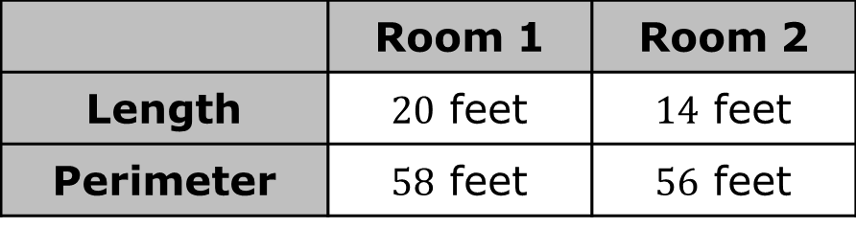
8.11.1 Warm-Up: Would You Rather?
Would you rather have Room 1 or Room 2?
Write an explanation of your choice.
 | Room 1 | Room 2
Length | $20$ feet | $14$ feet
Perimeter | $58$ feet | $56$ feet
volume 2, pg. 131

Slide 7

Guided Instruction
volume 2, pg. 131

Slide 8
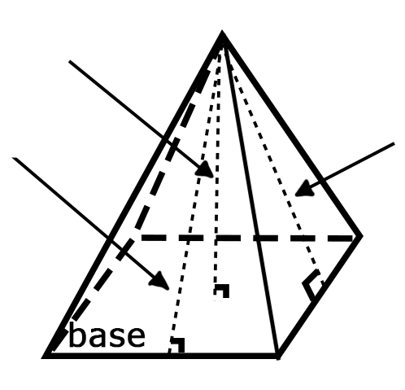



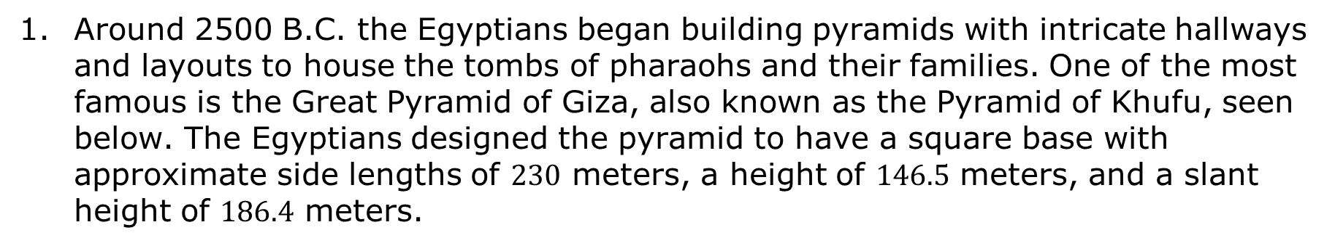

8.11.2 Guided Instruction: Surface Area of a Rectangular Pyramid
Around 2500 B.C. the Egyptians began building pyramids with intricate hallways and layouts to house the tombs of pharaohs and their families. One of the most famous is the Great Pyramid of Giza, also known as the Pyramid of Khufu, seen below. The Egyptians designed the pyramid to have a square base with approximate side lengths of $230$ meters, a height of $146.5$ meters, and a slant height of $186.4$ meters.
$146.5$ m
$186.4$ m
$186.4$ m
$230$ m
Looking at the model of the pyramid, why is there a measurement called height and a measurement called slant height?
volume 2, pg. 131

Slide 9

The slant height of the pyramid represents the height of each triangular face.
When finding the surface area of a pyramid, use the slant height to find the area of the faces.
volume 2, pg. 131

Slide 10
Using the information about the pyramid, complete the table to determine the surface area of the pyramid. Begin by labeling the sides of the net.
volume 2, pg. 132

Slide 11
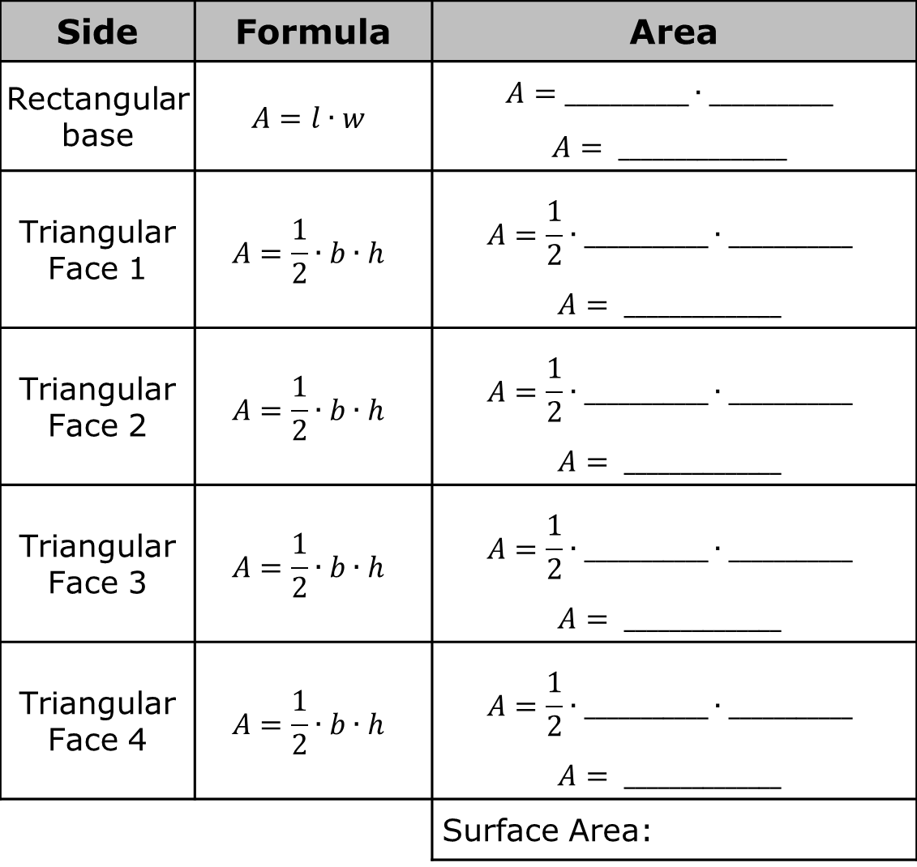
Side | Formula | Area
Rectangular base | $$A=l∙w$$ | $$A=___________∙___________$$ $$A= _______________$$
Triangular Face 1 | $$A=\frac{1}{2}∙b∙h$$ | $$A=\frac{1}{2}∙___________∙___________$$ $$A= ______________$$
Triangular Face 2 | $$A=\frac{1}{2}∙b∙h$$ | $$A=\frac{1}{2}∙___________∙___________$$ $$A= ______________$$
Triangular Face 3 | $$A=\frac{1}{2}∙b∙h$$ | $$A=\frac{1}{2}∙___________∙___________$$ $$A= ______________$$
Triangular Face 4 | $$A=\frac{1}{2}∙b∙h$$ | $$A=\frac{1}{2}∙___________∙___________$$ $$A= ______________$$
 |  | Surface Area:
volume 2, pg. 132

Slide 12
Complete the following statement.
To find the surface area of a rectangular pyramid you need
the sum of the of the base plus the area of
the other faces.
height
area
one of
all
volume 2, pg. 132

Slide 13

Collaboration
volume 2, pg. 133

Slide 14
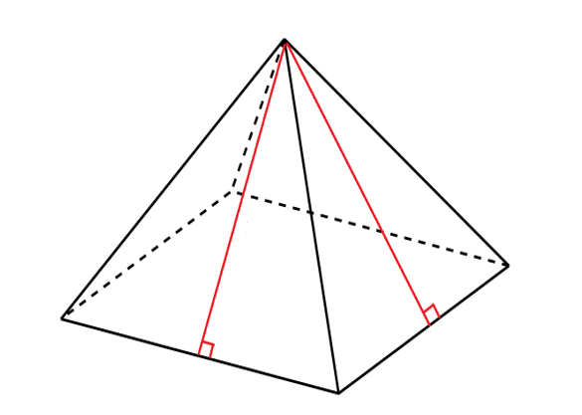




8.11.3 Collaboration: Surface Area of a Rectangular Pyramid
Papier-mache is a type of art that uses paper and glue. Jose is using the art of papier-mache to create a rectangular pyramid for his art project. To create his project, Jose needs to determine the amount of area that will be covered in newspaper. Below is the drawing Jose created to find the surface area.
Work with your partner to find the surface area of the pyramid.
$2.2$ ft
$2.1$ ft
$0.74$ ft
$1.6$ ft
volume 2, pg. 133

Slide 15

Your Turn
volume 2, pg. 133

Slide 16
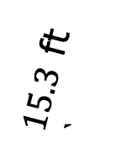
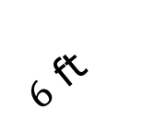
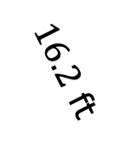
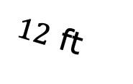
8.11.4 Your Turn!
Calculate the surface area for the pyramids.
Calculate the surface area of the pyramid.
$16.2$ ft
$15.3$ ft
`
$12$ ft
$6$ ft
volume 2, pg. 133

Slide 17
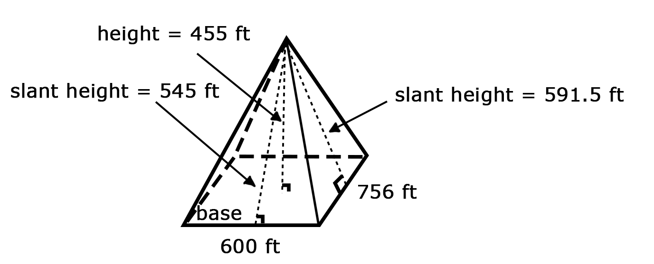
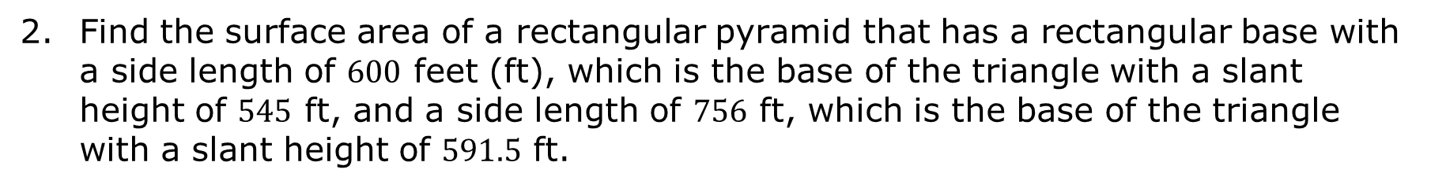
Find the surface area of a rectangular pyramid that has a rectangular base with a side length of $600$ feet (ft), which is the base of the triangle with a slant height of $545$ ft, and a side length of $756$ ft, which is the base of the triangle with a slant height of $591.5$ ft.
volume 2, pg. 134

Slide 18
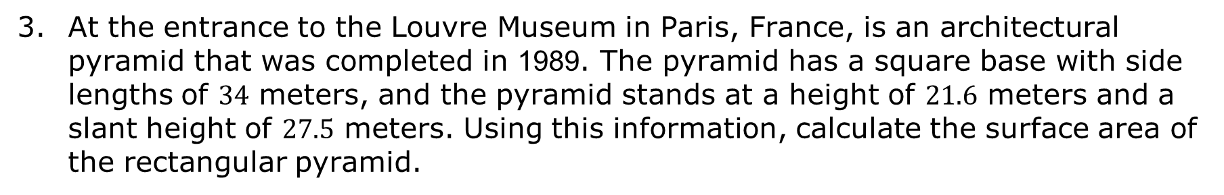
At the entrance to the Louvre Museum in Paris, France, is an architectural pyramid that was completed in 1989. The pyramid has a square base with side lengths of $34$ meters, and the pyramid stands at a height of $21.6$ meters and a slant height of $27.5$ meters. Using this information, calculate the surface area of the rectangular pyramid.
volume 2, pg. 134

Slide 19

Wrap-Up
volume 2, pg. 135

Slide 20
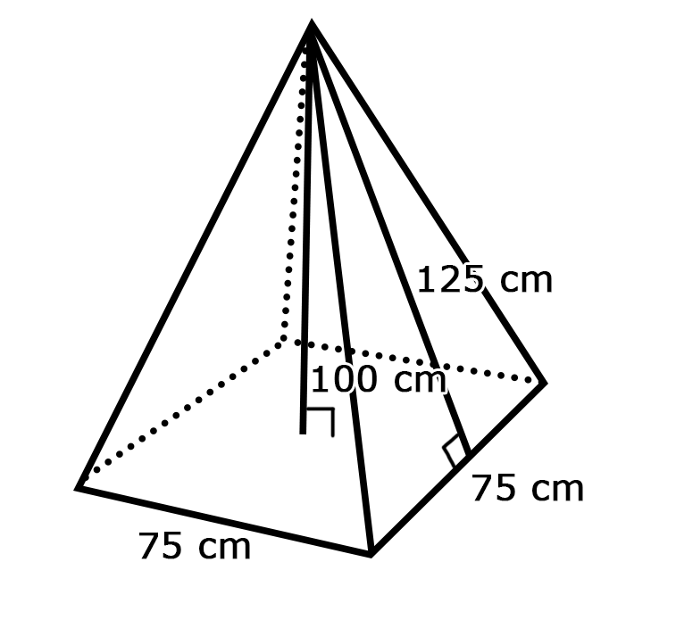
8.11.5 Wrap-Up: Ticket Out the Door
Find the surface area of a rectangular pyramid that has a square base with side lengths $75$ centimeters (cm), a height of $100$ cm, and a slant height of $125$ cm.
volume 2, pg. 135

